Slide 1



Transcriptional responses of a hot spring microbial mat to nutrient additions
Space Grant Consortium Research Symposium
Zureyma Martinez, ASU/NASA Space Grant
April 21, 2012

Slide 2
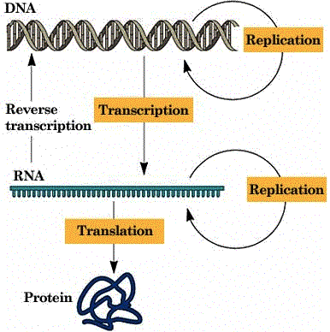
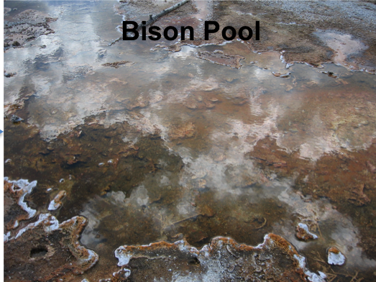
Introduction
Microorganisms can regulate metabolic processes by changing expression of genes.
In hot springs, microbial mats fix N at different times of the day based on expression of the nifH gene and nitrogenase protein (Steunou et al. 2008).
Notes:
Just to remind everyone, that genes encode proteins that carry out some function. The way organisms express proteins is first to transcribe DNA into mRNA and then that mRNA is translated into proteins.
By looking at mRNA expression, you can get an idea of what proteins organisms are making and thus what physiological functions they may be doing.
In fact, the expression of a gene involved in nitrogen fixation has been studied in hot springs using this approach.

Slide 3
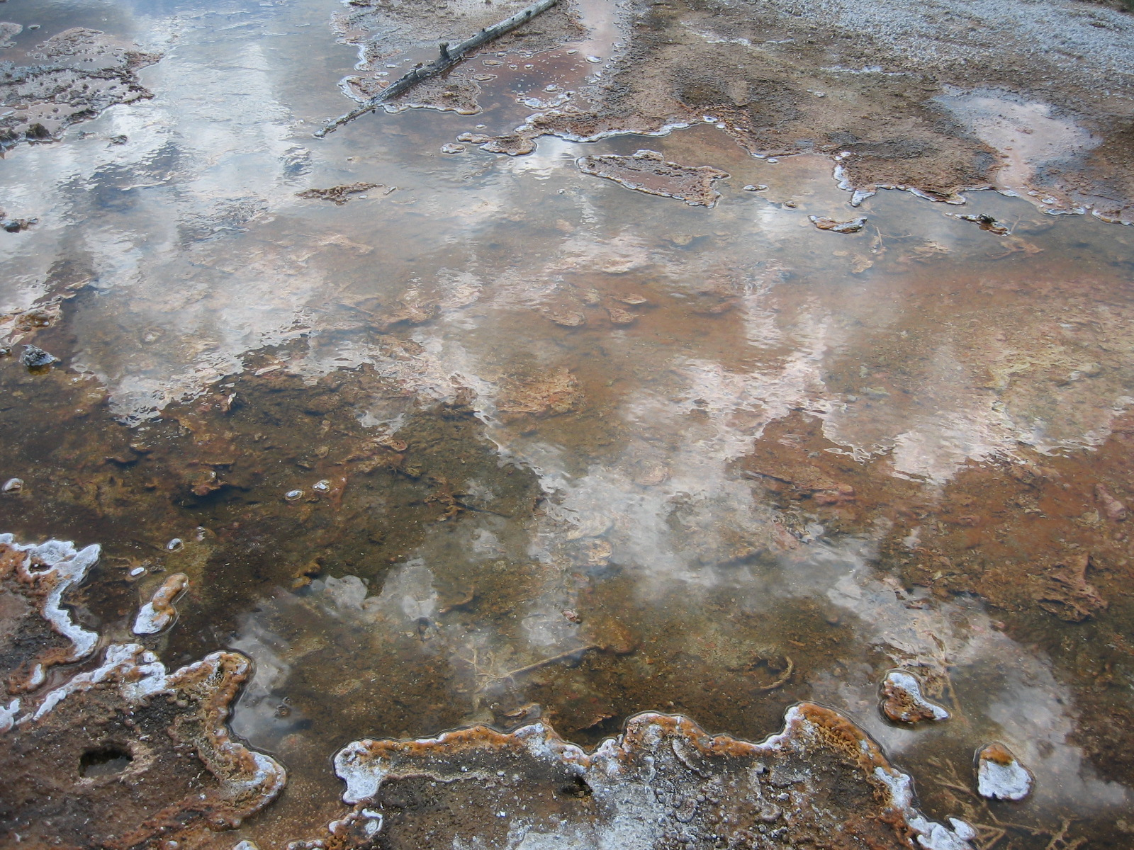
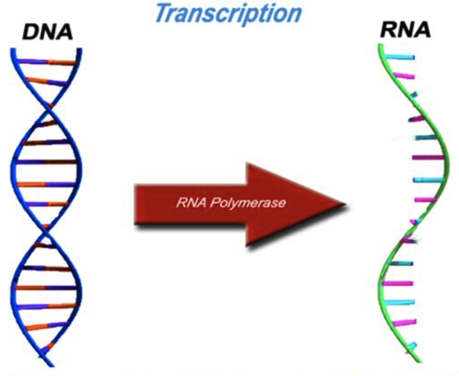
Introduction
Bison Pool
Bison Pool
Alkaline hot spring (pH 8) with a microbial mat at 55ºC
C, N, and metal storage gene expression in response to nitrogen (N), phosphorus (P), and iron (Fe) addition
+
Nitrogen
N
Notes:
Genes just aren’t expressed all the time. Sometimes organisms can express genes in response to environmental conditions.
For example, if you add N to a system, that N can be taken up by microorganisms and stimulate the expression of genes for N assimilation.
We know this occurs in laboratory cultures and many environments.
No one has done this study to see how hot spring microbial communities change gene expression in response to nutrient addition.
I’m working with the same samples that Christie talked to you about earlier. Just to remiBison Pool is an alkaline . . .
My question is whether expression of genes involved in C, N, and metal storage changed in response to N, P, and Fe addition.

Slide 4
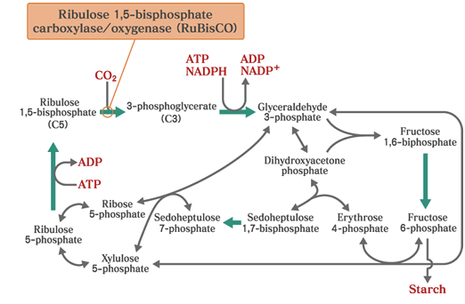
Introduction
Microbial mats are dominated by cyanobacteria that use the Calvin Cycle to fix CO₂
Key enzyme is the Ribulose 1,5-bisphosphate carboxylase/ oxygenase (RubisCO)
Large subunit of RubisCO is encoded by rbcL
Notes:
Microbial mats are dominated by cyanobacteria, which use the Calvin Cycle to fix carbon.
The Calvin Cycle is the most widespread CO2 fixation pathway.
The key enzyme is RubisCO, which catalyzes the carboxylation of ribulos1,5-bisphosphate
I’m going to look for rbcL expression

Slide 5
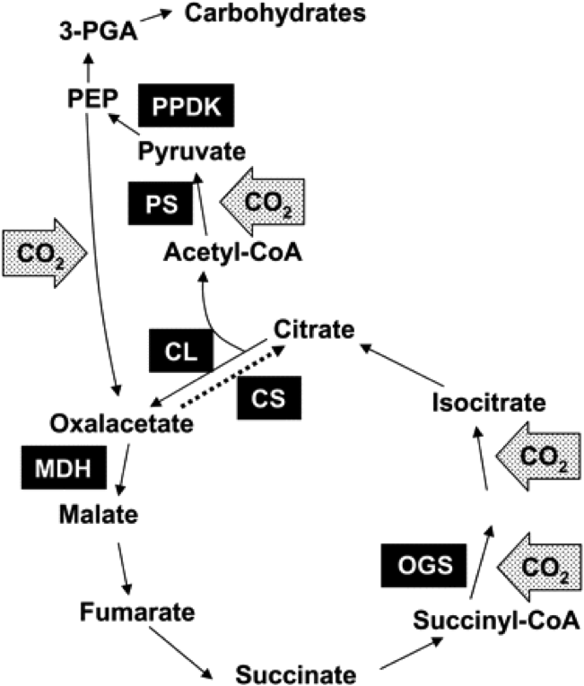
Introduction
Reductive tricarboxylic acid cycle
Alternative pathway for CO₂ fixation
Key enzyme is ATP citrate lyase encoded by aclB
Notes:
As an alternative, organisms can fix CO2 via the reductive TCA cycle.
Probably the most widespread pathway for CO2 fixation in anaerobes and microaerophilic organisms.
This pathway may be important in hot springs, especially at temperatures above 70oC.
This pathway is the reverse of the oxidative citric acid cycle. This pathway forms acetyl-CoA from two CO2 molecules.

Slide 6
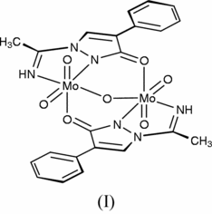
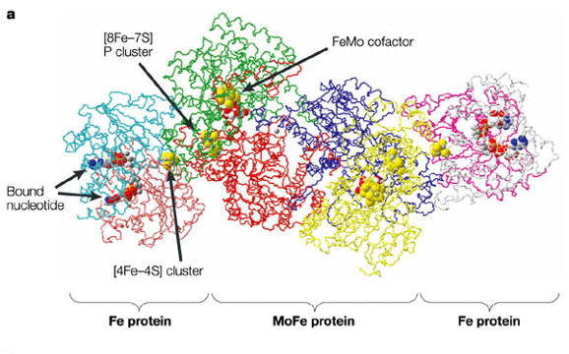
Introduction
Nitrogen fixation
Nitrogenase requires iron (Fe) and molybdenum (Mo)
nifH encodes subunit of nitrogenase
Microbes typically use trace concentrations of metal
Mo storage protein encoded by mop
Other N assimilation genes, like the assimilatory nitrate reductase require Mo
N₂ → NH₄⁺
Nitrogenase
Dixon and Kahn 2004 Nature Reviews Microbiology
Notes:
For example, two metals—molybdenum and iron—are important for the function of an enzyme called nitrogenase, which is depicted in this picture. Nitrogenase converts nitrogen (N₂) gas to ammonium and Mo and Fe participate in this reaction.
Metals can also be toxic to organisms, so many microbes use metals at low concentrations.

Slide 7
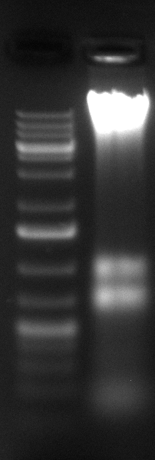
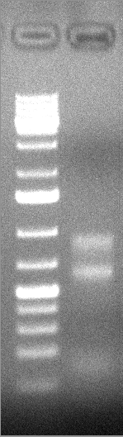
Methods
Bison Pool samples incubated overnight in bottles at in situ temperatures without nutrient addition (C) and with nutrient addition (N, P, Fe, NP, NFe, PFe, and NPFe)
Extract DNA/RNA
Reverse
PCR amplify w/ primers:
rbcL
acbL
nifH
mop
DNase
Degrade
DNA
Transcribed RNA into
cDNA
cDNA
Notes:
Basically, I extracted RNA from samples and then the RNA was transcribed into cDNA.
Then I used a technique called PCR to amplify the genes.
PCR allows you to make many copies of a small amount of DNA.

Slide 8
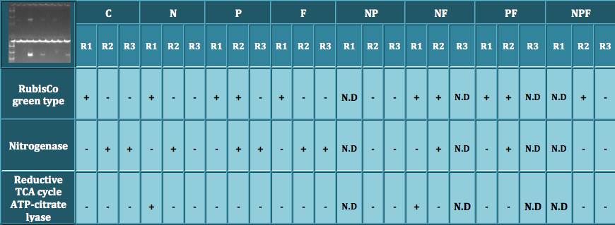

Results
RubisCO gene was expressed in almost all treatments
Reductive TCA cycle genes expression appears to be more transient

Slide 9
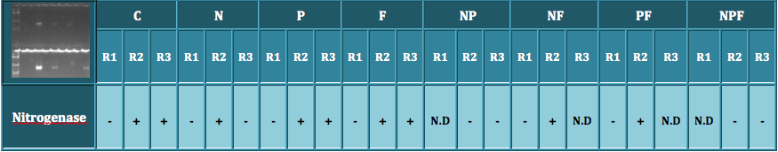
Results
NO₃⁻ Addition: 62.5 μM
NH₄⁺ Addition: 62.5 μM
mop expression not detected in any samples
nifH expressed even in presence of nitrate and ammonia

Slide 10
Summary & Future Work
Used gene expression as proxy for physiological processes (CO₂ fixation and N₂ fixation)
RT-PCR on heterotrophic carbon assimilation pathways
Clone and sequence putative rbcL and aclB genes
qPCR on nifH to quantify expression between treatments
Notes:
Here’s a tree showing the relationship between the mop clones and mop genes from sequenced organisms.
In the other tree shows the relationship between the NifH genes from sequenced organisms.
The clones are named using the initials of the hot springs, for example mop is mound pool and so on.
First, you can see that the sequences likely belong to cyanobacteria because they are grouping with cultured cyanobacteria, like Nostoc and the Yellowstone isolates designated by CYB and CYA
And they are most closely related to the Synechococcus sp mop genes
There doesn’t appear to be a geographic isolation of mop genes because you can see that clones from different springs are grouping together

Slide 11
Acknowledgements
Marcia Kyle
Jess Corman
Amisha Poret-Peterson
James Elser
Ariel Anbar
Alisa Glukhova
Christie Sabin

